Slide 1
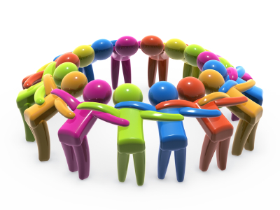
Team Building

Slide 2
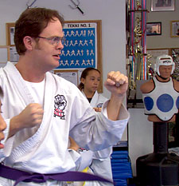
Negative Group Roles
‘Isolator’ - Doesn’t participate
‘Dominator’ – Speaks too often or too long
‘Free Rider’ – Doesn’t do his share
‘Detractor’ - Complains or criticizes
‘Socializer’ - pursues social aspect only

Slide 3
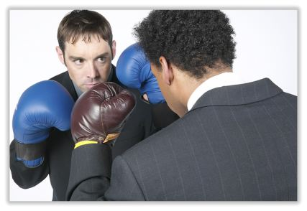
Group Conflict
Personal - dislike someone
Group – disagreeing on plans, ideas, strategies
Remember:
What is the common group goal?
A ‘devils advocate’ is okay.
Create formal rules
to focus on the tasks

Slide 4
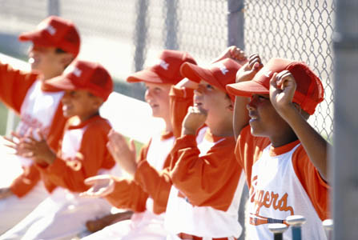
Conflict is a normal part of any team effort
Focus on the issues, not on the personalities
Conflict should be productive, not destructive
Conflict can lead to creative discussions and
superior outcomes.

Slide 5
Group decision-making
Can be challenging
Consider multiple ideas and merge into one
Four healthy stages of Decision-Making:
Orientation Stage
Identify the problem and plan a process
Discussion Stage
Gather information and weigh options
Decision Stage
Delegate, vote, come to a consensus
Implementation Stage
Carry out the decision and assess it

